Slide 1
General Meeting
Please turn phones to vibrate or off
ASBL: 874.358.592 | Square du Vieux Tilleul 1/4, 1050 Ixelles, Belgium

Slide 2
General Meeting
10h - 12h
9 September 2014
ASBL: 874.358.592 | Square du Vieux Tilleul 1/4, 1050 Ixelles, Belgium

Slide 3
Agenda
Welcome by Jimmie Bradshaw
Welcome and Farewells to Members
VOTE: Approval of minutes from the GM at 17 June 2014
Guest Speaker by Carla Bucalossi, NIC President
Vice-President & Guest Access by Beckie Metelko
Treasurer Update by Alessandra Foresti
Membership Update by Trine Lauvsnes
Bazaar Update by Emily Michnay
Tombola Update by Carla Bucalossi
Charity Selection 2014 by Julija Vejic Coffee Break (15 minutes)
Charity Selection 2014 (continued)
Restaurant Update by Christina Arvanitaki
Sponsorship, Events, Bake Sales by Dionysia Leolei
Any other Business and Closing by Jimmie Bradshaw

Slide 4
Farewell to Members Jimmie Bradshaw - President

Slide 5
Welcome to Members Jimmie Bradshaw - President
Belgium – 2nd ANR - Serge Devynck
Denmark – 2nd ANR - Bethina Sadolin
Estonia – 2nd ANR – Teele Treu
Sweden – ANR – Annika Ivarsson
Switzerland – ANR – Katharina Garbe
Welcome on Board ☺

Slide 6
VOTES Jimmie Bradshaw - President
Approval of: 1) Minutes from 17 June 2014

Slide 7
Guest Speaker
Carla Bucalossi Quatrini
President, NATO International Club
Natointernationalclub.org

Slide 8
Guest Access Beckie Metelko – Vice-President & Guest Access
Helpers
Use NATO personnel & family first
Only 12 helpers per country for one stand, 18 for two stands
Only valid for one day
Guests
Other
VIP’s
Musicians/Entertainment

Slide 9
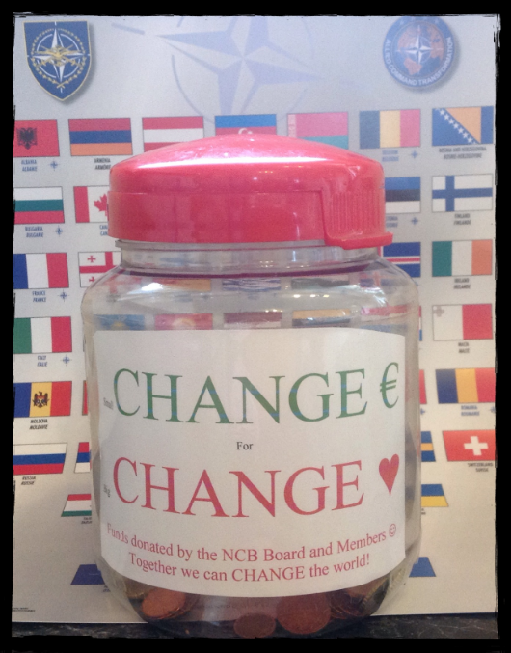
Change Jar Beckie Metelko – Vice-President & Guest Access

Slide 10
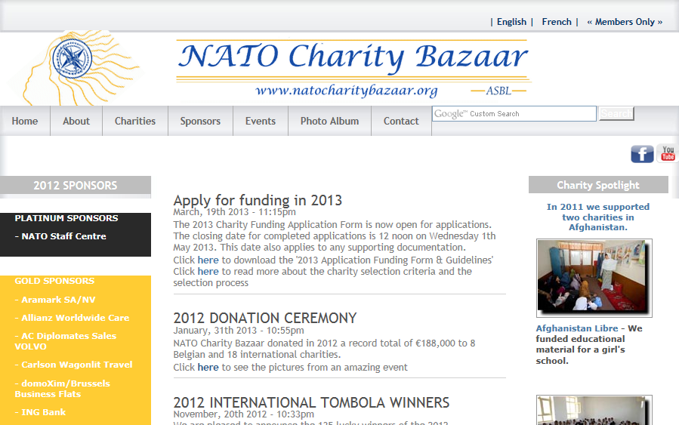
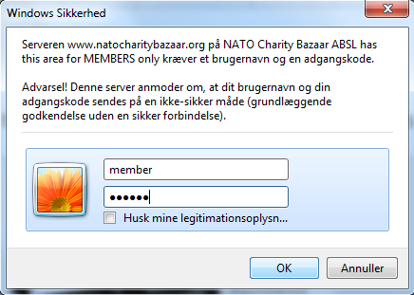
Web Site Access Beckie Metelko – Vice-President & Guest Access
www.natocharitybazaar.org
User Name: member
Password: member
User Name: members
Password: members
User Name: membre
Password: membre

Slide 11
Web Site Access Beckie Metelko – Vice-President & Guest Access

Slide 12
Treasurer’s Report Alessandra Foresti - Treasurer
Treasurer Update
Notes:
12
12
12

Slide 13
Treasurer Update Alessandra Foresti - Treasurer
TOTAL INCOME 2014
- Events (Shen Yun, Hulencourt) 1.357 €
- Bake Sales 3.087 €
- Small change for big change 107 €
- Loyality Pemium BMPB 17 €
New entry
«Behind the Silk Curtain, by Gulistan Khamzayeva, book sale» = 780 €
5.348 EUROS
On 07 September 2014
Notes:
13
13
13
13

Slide 14
Membership Database Trine Lauvsnes– Membership Coordinator

Slide 15
Membership Database Trine Lauvsnes– Membership Coordinator

Slide 16
Membership Database Trine Lauvsnes– Membership Coordinator
Please verify your contact information!

Slide 17
Bazaar Update Emily Michnay - Bazaar Coordinator

Slide 18
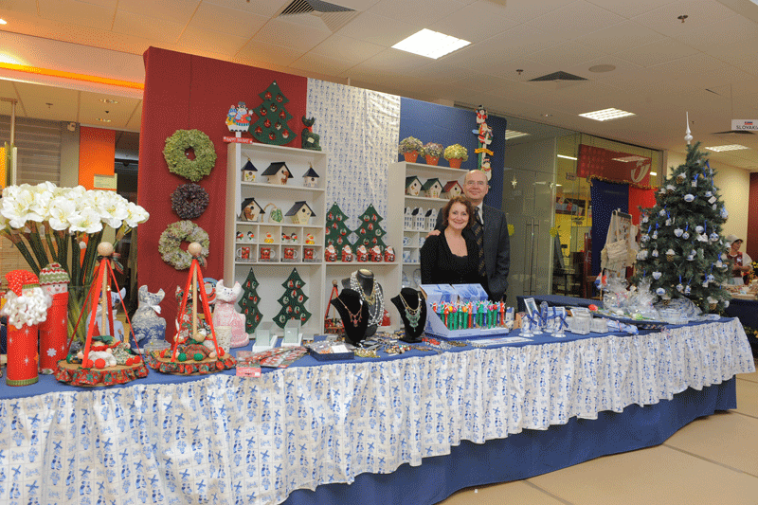
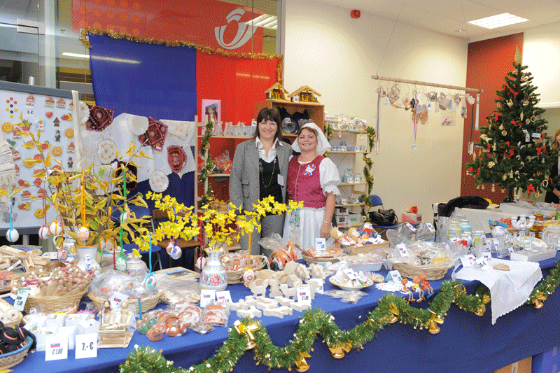
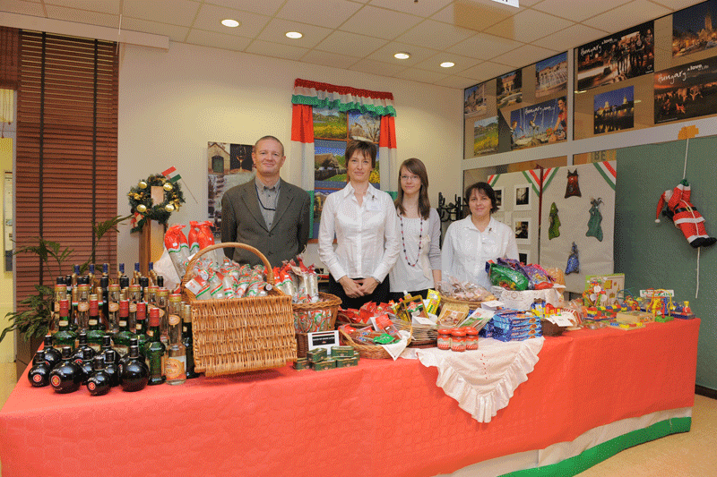
Decorate your stands elaborately and festively.

Slide 19
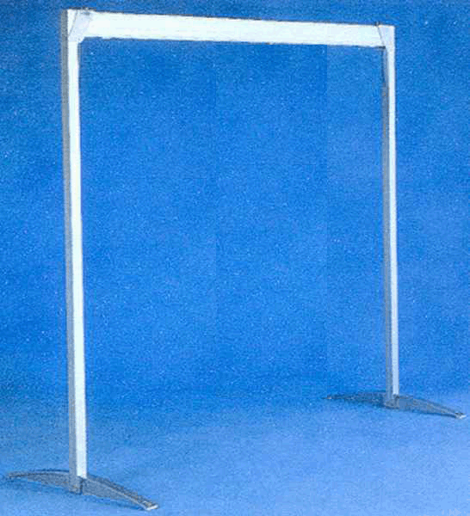
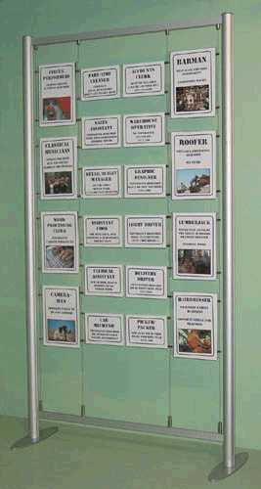
Decorating Your Stand Emily Michnay -- Bazaar Coordinator
No Material may be attached to NATO walls or ceiling
ONLY freestanding frame or shelving are allowed

Slide 20
Decorating Your Stand Emily Michnay -- Bazaar Coordinator
You can decorate your stands as you wish. However we must follow NATO RULES for decorations:
No nails, tacks or glue on the walls
No staples or other damaging materials on the tables
Only country plaques may be hung from the ceiling
No burning candles

Slide 21
NATIONAL STANDS
WE PROVIDE
Tables (2-6)
2-4 chairs
Nation Name Plate
Access to Electricity
YOU PROVIDE
Power Cords/ extension cords
Decorations for table
Free standing frame for hanging decorations
Tools to put up your decorations
Notice Boards

Slide 22
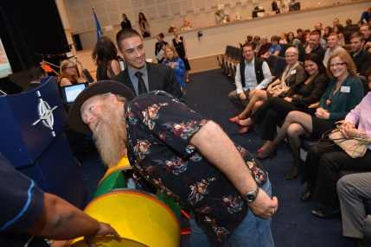
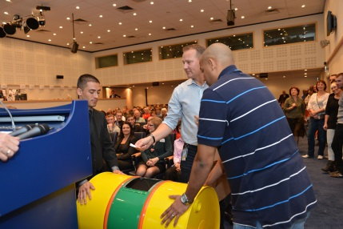
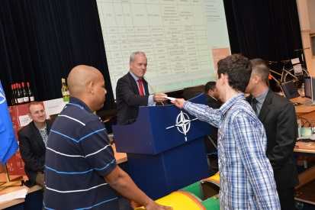
Tombola Update Carla Bucalossi Quatrini - Tombola Coordinator
Tombola Ticket Sales Lottery Sept 23
List of Tombola Prizes + Pictures of the prizes for book
Tombola Tickets distributed at the 23th September General Assembly Meeting Tombola Tickets Sales begin – 29 Sept
SMS service for prize winners

Slide 23
Tombola Overview Carla Bucalossi Quatrini - Tombola Coordinator
Tombola - A giant raffle
Tickets price: 2.50 € each
Prizes - Each nation provides at least two (2) prizes worth at least 100 € each
Ticket Sales - All nations sell tickets
Winners - The winners are drawn at the Bazaar

Slide 24
Tombola Prize List Carla Bucalossi Quatrini - Tombola Coordinator
An e-mail including this information is accepted
Please remember pictures of the prizes as attachments ☺

Slide 25
Ticket Sales Carla Bucalossi Quatrini - Tombola Coordinator
LOTTERY DURING SEPT 23 MEETING

Slide 26
2014 Tombola Ticket Sales Dates Carla Bucalossi Quatrini - Tombola Coordinator
SALES DATES:
September: 29, 30
October: 1, 3, 6, 8, 9, 10,13, 14, 15, 16, 17, 22, 23, 24, 27, 28, 29, 31
November: 5, 6, 7, 10, 11, 12, 13 14
LOCATIONS:
Press Hall September 29-Oct 10, Oct 22-Nov 7 NATO Cafeteria (right next to the entrance to the Self Service Restaurant)
Oct 13-17, Nov 10-14

Slide 27
2014 Tombola Ticket Sales Carla Bucalossi Quatrini - Tombola Coordinator
Please fill out the tombola ticket questionnaire and return it to Carla or Marilena before the end of the meeting!

Slide 28
Charity Selection & Voting Process Jimmie Bradshaw – President

Slide 29
Charity Selection Overview Jimmie Bradshaw – President
A list of criteria's
Reviewing Process
Eligible charities
Voting Process
Selected for funding
Donation
This information may be found on our website

Slide 30
Charity Voting Process Jimmie Bradshaw – President
Ballots are in your meeting folder: Belgian Charities Ballot and International Charities Ballot
Name of nation voting is on each page of the ballot (for accountability use only)
Belgian Ballot is 2 pages long, International Ballot is 4 pages long

Slide 31
Charity Voting Process Jimmie Bradshaw – President
Change in voting procedure!
Rank charities 1-10 (Belgian) and 1-25 (International)
Numbers will be added; charities with the LOWEST score will be given priority
Calculation example: 1+1+2+1+3+8+2 = 18 (1st priority)
4+9+9+2+2+10+9 = 45 (2nd priority)
5+7+8+6+5+7+8= 46 (3rd priority)
In case of a tie, the charity with the most 1’s will take priority

Slide 32
17
EXAMPLE
1
14
23
Categories: Rank each charity 1-25 (International) and 1-10 (Belgian)
Every charity must be ranked: If a charity on a ballot is not ranked, it will automatically be made a 25th choice.

Slide 33
9
EXAMPLE
1
5
Time to confer with your delegation before submitting your final ballot
Ballots will be collected for Belgian Charities before beginning discussion of International Charities

Slide 34
Belgian Charity Presentation Emily Michnay
Please follow along on your ballot

Slide 35
Belgian Charity Voting Julija Vejic - International Charity Coordinator
PLEASE VOTE FOR THE 2014 BELGIAN CHARITIES

Slide 36
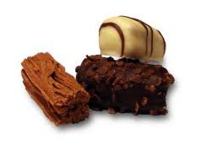
Coffee Break 15 min
Thank you

Slide 37
International Charity Presentation Julija Vejic - International Charity Coordinator
Please follow along on your ballot

Slide 38
International Charity Voting Julija Vejic - International Charity Coordinator
PLEASE VOTE FOR THE 2014 INTERNATIONAL CHARITIES

Slide 39
Restaurant Update Christina Arvanitaki - Restaurant Coordinator
Latest Update
Each nation need to find a Restaurant Coordinator + Ass. Restaurant Coord.
2014 Forms will be on our website soon
2 special restaurant coordinator meetings before the bazaar
First Meeting: October 16, 1030-1130 in the Grand Chalet
Second Meeting: November

Slide 40
Sponsors & Events Dionysia Leolei, Sponsors & Event Coordinator
CONFIRMED SPONSORS 2014

Slide 41
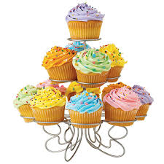
Bake Sale Dionysia Leolei, Sponsorship & Events, Bake Sales

Slide 42
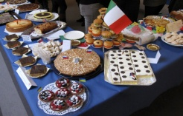
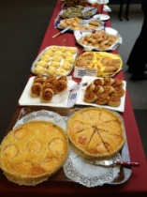
BAKE SALE REMINDERS Dionysia Leolei, Sponsorship & Events, Bake Sales
WHAT TO BRING
Baked Good(s) Sweet or Savory

Slide 43
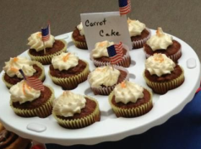
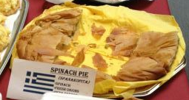
BAKE SALE REMINDERS Dionysia Leolei, Sponsorship & Events, Bake Sales
A SHORT DESCRIPTION
(i.e. Apple Crumb Cake with Walnuts, Spinach and Cheese Pie)

Slide 44
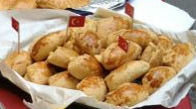
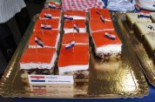
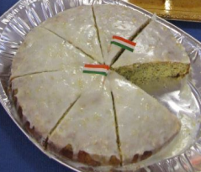
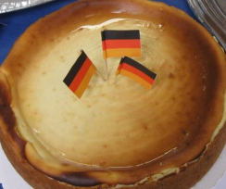
BAKE SALE REMINDERS Dionysia Leolei, Sponsorship & Events, Bake Sales
SMALL COUNTRY FLAGS

Slide 45
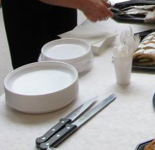
BAKE SALE REMINDERS Dionysia Leolei, Sponsorship & Events, Bake Sales
Paper plates
Napkins
Plastic spoons or forks
Cutting/serving utensils
Small or medium, sturdy, (labeled with your name, country and phone number)

Slide 46
BAKE SALE REMINDERS Dionysia Leolei, Sponsorship & Events, Bake Sales
DELIVER NO LATER THAN 08:30
IN THE PRESS HALL IN FRONT OF LUNS THEATRE (ING BANK)

Slide 47
BAKE SALE REMINDERS Dionysia Leolei, Sponsorship & Events, Bake Sales
PICK UP NO LATER THAN 13:30 (1:30 pm)
IN THE PRESS HALL IN FRONT OF LUNS THEATRE (ING BANK)

Slide 48
BAKE SALE REMINDERS Dionysia Leolei, Sponsorship & Events, Bake Sales
REMEMBER !
LABEL ALL SERVING DISHES/UTENSILS WITH
NAME, PHONE NUMBER, NATION

Slide 49
Any other business Jimmie Bradshaw - President
New Board Members
Hosting Patrons & Sponsors Coffee (morning of the bazaar)
Webmaster

Slide 50
Bake Sale Today!!!
Bosnia & Herzegovina, Serbia, and Croatia invite you to a bake sale today in the press hall from 0900-1400
All proceeds go towards relief efforts from the flooding earlier this year

Slide 51
Closing Jimmie Bradshaw - President
General Meeting Dates 2014
23 September
Key Focus: Announcement of charities selected for funding, Tombola Ticket Sales Schedule, Bazaar Instructions & Call for Entertainment
07 October & 21 October
Key Focus: VIP & Visitor Passes
6 November
Key Focus: Final Instructions & After Sales Schedule
Please return voting cards and folders

Slide 52
Sponsors & Events Dionysia Leolei, Sponsors & Event Coordinator
CONFIRMED SPONSORS 2014

